Slide 1
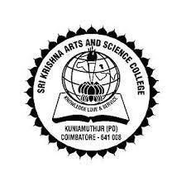
Sri Krishna College of Arts and Science
Capstone Project on LMW
Under the Guidance of :
Dr. R. Sangeetha MIB, MBA, Ph.D
Assistant Professor
Department of Commerce AF & IB
By,
Vijay Anandh. A
22BAF157
2nd B.Com A&F

Slide 2
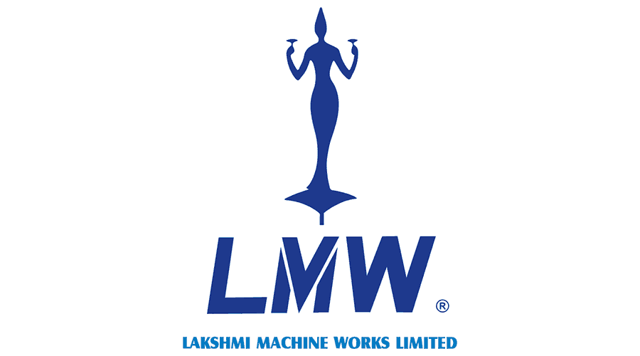
Introduction
Lakshmi Machine Works (LMW) is one of the leading Textile Machine Manufacturer in India and playing vital role in manufacturing of Textile machines and holding 3 places in world One among the third place in the world to produce entire range of spinning machinery. It was founded in 1962 and now its products are exported to Asia and oceanic regions. LMW is also diversified into CNC machine tools and it hold the leadership in manufacturing the customized products.

Slide 3
History
Lakshmi Machine Works (LMW) was founded in 1962 in Periyanaickanpalayam, Coimbatore. The company was established to provide Indian textile mills with the latest spinning technology. LMW is one of India's largest textile machinery manufacturers. It also manufactures machine tools and foundry products.
Following are key stages of evolution
Incorporation on September 14, 1962
Technical collaboration with Swiss-based textile machinery manufacturer Rieter and German-based Steel & Ammunition major
Offering 1,00,000 shares to the public in February 1964
Allocating 30,133 shares to technical collaborators in 1968
Issuing a further 10,000 shares to technical collaborators in 1971
Diversifying into CNC Machine Tools and manufacturing customized products

Slide 4
Product Line
The Product line of this company are as follows:
Baleplucke LA23/S
Swift Floc LA21
Vario Clean LB 9/2
Unimix LB 7/4
Unimix LB 7/6
Flexi Clean LB 5/6
Supremo Clean LB 10/2
Card LC343/ LC361
Card LC636 S
Draw Frame LDB3 S
Lap Former LH20 S
Lap Former LH15
Comber LK64 Z
Comber LK69 M/S
Draw Frame LDF3 S
Speed Frame LF1400 A
Speed Frame LF4280
Ring Frame LR9 A/AX/AXL Series
Ring Frame LR9 SX/SXL Series

Slide 5
Marketing Strategy
LMW, or Lakshmi Machine Works Limited, is a leading textile machinery manufacturer based in India. As of my last knowledge update in September 2021, some general insights into LMW's marketing strategy. Please note that their strategy may have evolved since then, and I recommend checking their latest reports and materials for the most current information.
Product Quality and Innovation:
Customer-Centric Approach:
Global Expansion:
Digital Marketing:
Trade Shows and Exhibitions:
After-Sales Support:

Slide 6
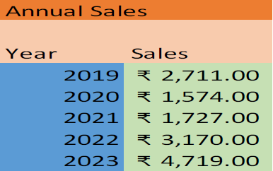
Sales Growth
Sales For past 5 Years

Slide 7
Market Share
India
World
1) Tamil Nadu
2) Andhra Pradesh
3) Hyderabad
4) Kolhapur
5) Mumbai
6) Nagpur
7) Kolkata
8) Indore
9) Ahmedabad
10) Delhi
11) Chandigarh
1) Bangladesh
2) Thailand
3) Vietnam
4) Indonesia
5) Kenya
6) Egypt
7) Turkey

Slide 8
Implementation of Technology
In 2010, LMW has added the Advanced Technology Centre (ATC), a new plant to produce systems, modules, assemblies and components for Aerospace and Defense sector. The facility spans the composite and metallic arena.
LMW ATC is one stop solution to the Aerospace customer. In terms of infrastructure and capability, ATC has world class manufacturing facilities and its Quality Assurance standards are aligned to AS 9100D certification and NADCAP for special process viz Chemical Process, NDT, Welding, Heat treatment and Composites. ATC has ongoing projects with major OEMs & Tier 1’s in US, Europe and various divisions of Hindustan Aeronautics Limited (HAL) as well as Defense Research & Development Organization (DRDO) and Indian Space Research Organization (ISRO). Aerospace Composite facility has international class processing and assembly facility to deliver a spectrum of composite and hybrid structures for space, aviation and strategic requirements meeting all the quality protocols.

Slide 9
R&D
Lakshmi Machine Works (LMW) is one of the leading Textile Machine Manufacturer in India and playing vital role in manufacturing of Textile machines and holding 3 places in world One among the third place in the world to produce entire range of spinning machinery. It was founded in 1962 and now its products are exported to Asia and oceanic regions. LMW is also diversified into CNC machine tools and it hold the leadership in manufacturing the customised products.
LMW-ATC (Lakshmi Machine Works – Advanced Technology Centre) Has contributed the success of Chandran-III, launched on Friday by ISRO using LVM3 Launch Vehicle. This Launch vehicle would carry Lander and Rover Configuration to 100 Km Lunar Orbit

Slide 10
SWOT Analysis

Slide 11
Conclusion
From the overall analysis of the company, we can clearly say that the company is performing in a very effective and efficient manner and you might also see that the company is not increasing its loan or advances. Finally, this company is financially and operationally it is very good. It is a boom to the investors to invest in this company as the company share price will be moving in the upwards only as all the factors which support the company to increase its share price is available in this company.

Slide 12


